Slide 1
LINEAR FUNCTIONS
CHAPTER 6

Slide 2
TABLE OF CONTENTS
6.1 Slope of a Line
6.2 Slopes of Parallel and Perpendicular Lines
6.3 Math Lab: Investigating Graphs of Linear
Functions
6.4 Slope-Intercept Form of the Equation for a
Linear Function
6.5 Slope-Point From of the Equation for a Linear
Function
6.6 General Form of the Equation for a Linear
Function

Slide 3
General Outcome
Develop algebraic and graphical reasoning through the study of relations.

Slide 4
Specific Outcomes
Students will be expected to:
demonstrate an understanding of slope with respect to rise and run, line segments and lines, rate of change, parallel lines, and perpendicular lines.
describe and represent linear relations, using words, ordered pairs, tables of values, graphs, and equations.
determine the characteristics of the graphs of linear relations, including the intercepts, slope, domain, and range.
determine the equation of a linear relation to solve problems, given a graph, a point and the slope, two points, and a point and the equation of a parallel or perpendicular line.
solve problems that involve the distance between two points andthe midpoint of a line segment.

Slide 5
OPENING ACTIVITY

Slide 6
Class inquiry

Slide 7
Vocabulary
roof
steep (steepness)
corresponding
slope
gradient
match

Slide 8
Introduction

Slide 9
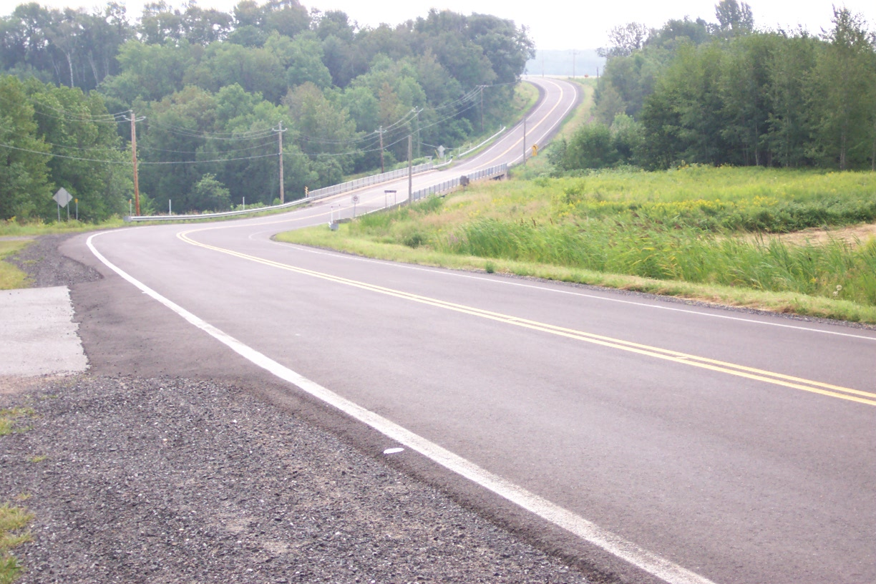
Around Us…

Slide 10
Slope
What is slope?
Why do we want to know?
Look at the relationship between rise and run in each of the lines. That would define the slope of the line.
y
X

Slide 11
Slopes and Lines
rise
run
The slope of a line is the steepness of the line.

Slide 12
Determine the slope of the line.
5 cm
9 cm
We use the letter m because in French the word for “to go up” is monter.
Because the slope is a ratio, there are no units such as cm or cm².

Slide 13
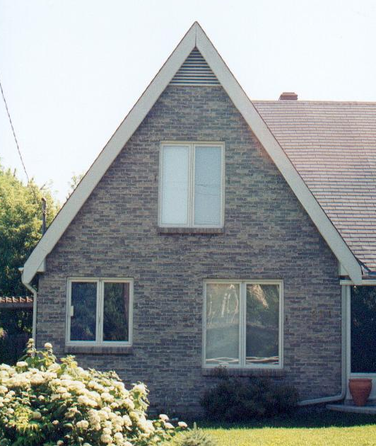
Determine the slope (pitch) of the roof.
5 m
3 m

Slide 14
Determine the slope of the staircase.
2
3
3
3

Slide 15
Determine the slope.
12
10
9
8
3
6
4
2
0
2
4
6
8
10
12
14
Notes:
Confirm with the class that other points on the line besides (4,6) and (13,9) would also have given slope 1/3.

Slide 16
Determine the slope.
12
10
8
– 5
6
7
4
2
0
2
4
6
8
10
12
14
Notes:
A student may ask about the possibility of seeing the upward/positive rise from (11,5) to (4,10) as 5. Confirm that this is correct, but would generate a negative/leftward run of –7 and yield the same negative slope.

Slide 17
Determine the slope.
12
10
7
8
6
4
2
Horizontal lines have a slope of zero.
0
2
4
6
8
10
12
14
Notes:
The run between the green points is 7. The line does not rise between the green points, so rise =0.
No matter what two points are chosen on the red line, rise will be 0 and run will be positive (rightward) or negative (leftward). Since 0/+=0 and 0/-=0, the slope will 0.

Slide 18
Determine the slope.
12
10
6
8
6
4
Vertical lines have slopes which are undefined.
2
0
2
4
6
8
10
12
14
Notes:
The rise between the green points is 6, but, this time, the run is 0.

Slide 19
Summary: Types of Slopes
negative
positive
undefined
zero
Notes:
Summary: Types of Slopes

Slide 20
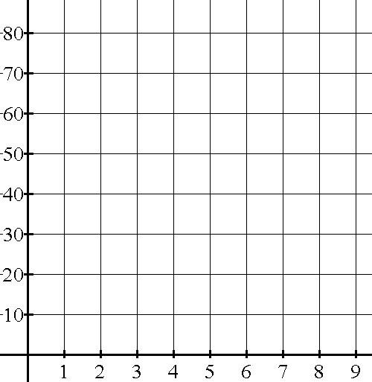
Determine the slope of this line.
Which points will you use to determine rise and run?
40
5
= 8
Notes:
M=rise/run
To measure rise and run, we could count squares between 2 points on the line. From the graph it is easy to read the coordinates of (2,30) and (7,70) since these fall on grid lines.
Mark these 2 points and use the given scales to measure rise and run.
Rise =40
Run=5
M=40/5
M=8

Slide 21
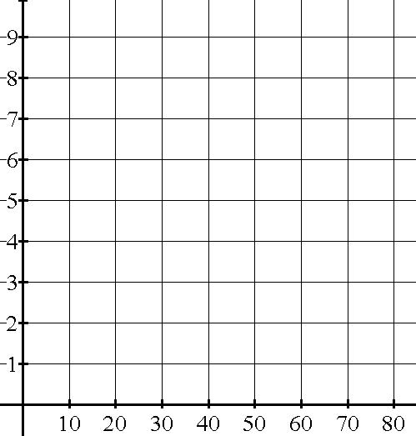
Determine the slope of the line segment.
–2
60

Slide 22
Draw a line which has a slope of
Draw a line which has a slope of 2

Slide 23
Draw a line which has a slope of
–5
6
–5
6

Slide 24
Draw a line which has a slope of …
a) – 3
b) 3
1
–3
3
1
1
–3
3
1

Slide 25
Let’s take some examples
from the textbook,
pages 334-338.

Slide 26
EXPLORE!!!
http://www.mathsisfun.com/equation_of_line.html

Slide 27
PRACTICE EXERCISES
Answer # 4-9 on pages 339-340.
HOMEWORK
Answer # 11-23 on pages 340-341.

Slide 28
References
http://www.mathsisfun.com/equation_of_line.html
http://ilovemathisfun.weebly.com/unit-3---relations-and-functions.html
http://www.sd43.bc.ca/Resources/ParentResources/math/10/Pages/LinearFunctions.aspx

