Slide 1
Acceleration
Chapter 11
Ms. Lilian Albarico

Slide 2
11.1 Describing and Measuring Acceleration

Slide 3
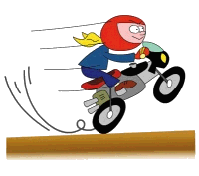
Acceleration
When a motorcycle moves faster and faster,
its speed is increasing
(velocity changed).

Slide 4
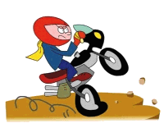
Acceleration
When a motorcycle moves slower and slower,
its speed is decreasing
(velocity changed).

Slide 5
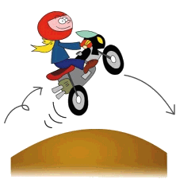
Acceleration
When a motorcycle changes direction,
its velocity changes too.

Slide 6
Acceleration
Acceleration measures the change in velocity
direction
speed
Acceleration = Δvelocity per unit time
overall change in velocity
=
total time taken
vector quantity
Unit: m s^{–1} / s
= m s^{–2}
= m/s²

Slide 7
Acceleration
If a car accelerates at 2 m/s², what does that mean?
t = 0
v = 0
t = 1 s
v = 2 m/s,
Δv = 2 m/s
1 m
t = 2 s
v = 4 m/s,
Δv = 2 m/s
3 m
t = 3 s
5 m
v = 6 m/s,
Δv = 2 m/s

Slide 8
Example 1
1 km/h
A
B
2 km/h
Suppose AB = 1 km
⇒ whole journey = 2 km
Time for whole trip =
= 1 h + 0.5 h = 1.5 h
Average Speed = distance / time
= 2 km/1.5 h
= 1.33 km/h

Slide 9
Example 2
A car travels 7 km north and then 3 km west in 10 minutes.
Find the average speed.
Ave. speed =
3 km
C
B
distance travelled
time taken
7 km
(7 + 3) km
=
= 60 km/h
(10/60) h
A

Slide 10
Example 3
A car travels 7 km north and then 3 km west in 10 minutes. Find
(b) ave. velocity?
3 km
C
B
AC =
7 km
= 7.62 km
θ
tan θ =
3/7
⇒ θ =23.2º
A

Slide 11
Example 3
A car travels 7 km north and then 3 km west in 10 minutes.
Find
the average velocity.
AC = 7.62 km, θ =23.2º
3 km
C
B
Size of average velocity =
displacement
7.62 km
7 km
=
time
(10/60) h
θ
= 45.7 km/h
Average velocity is 45.7 km/h, 23.2° north of west.
A

Slide 12
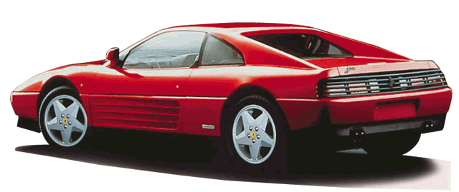
Example 4
The Ferrari 348 can go from rest to
100 km/h in 5.6 s.
What is its average acceleration (in m/s²)?
Average Acceleration
=
100 km/h
(100/3.6) m/s
=
5.6 s
5.6 s
= 4.96 m/s²

Slide 13
Example 5
A particular car can go from rest to 90 km/h in 10 s. What is its acceleration?
(90 km/h – 0)/10 s = 9 km/h/s

Slide 14
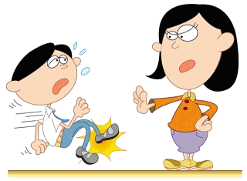
Q1 A running student...
A running student is slowing down in front of a teacher.
+ve
With reference to the sign convention,
Velocity of student: positive / negative
Acceleration of student: positive / negative

Slide 15
Q2 When time is measured...
Unit of time: hour (h)
Unit of distance/displacement: kilometer (km)
Quantity Unit Scalar/Vector
Speed ______ _____
Velocity ______ _____
Change in velocity ______ _____
Acceleration ______ _____
Km/h
scalar
Km/h
vector
Km/h
vector
Km/h²
vector

Slide 16
Q3 In 2.5 s, a car speeds up...
In 2.5 s, a car speeds up from 60 km/h to 65 km/h...
…while a bicycle goes from rest to 5 km/h.
Which one has the greater acceleration?
They have the same acceleration!

Slide 17
In 2.5 s a car increases its speed from 60 km/h to 65 km/h while a bicycle goes from rest to 5 km/h.
Which undergoes the greater acceleration?
What is the acceleration of each vehicle?
Car: (65 km/h – 60 km/h)/2.5 s = 2 km/h/s
Bike: (5 km/h – 0)/2.5 s = 2 km/h/s

Slide 18
Q4 A car is moving in positive...
A car is moving in (+) positive direction.
What happens if it moves under a (−) negative acceleration?
The car will slow down.
What happens if it moves under a (−) negative deceleration?
The car will move in (+) positive direction with increasing speed.

Slide 19
Remember!
Acceleration= final velocity- starting velocity
time
Change in velocity = final - starting velocity velocity
Acceleration= change in velocity
time

Slide 20
11.2 Using and Picturing Acceleration

Slide 21
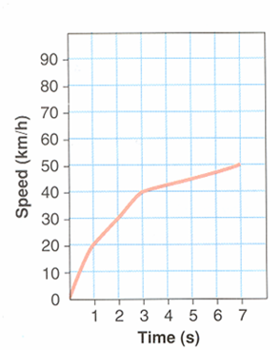
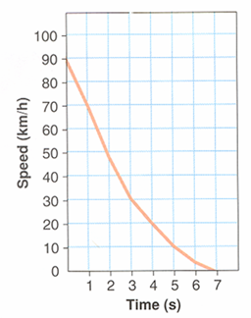
Positive acceleration
Negative acceleration

Slide 22
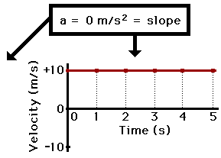
Acceleration – Slope of V-T – 1
Time (s) | Velocity (m/s)
0 | 10
1 | 10
2 | 10
3 | 10
4 | 10
5 | 10
Graphics from Minds On Physics

Slide 23
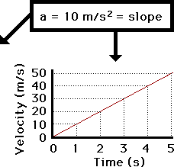
Acceleration
Time (s) | Velocity (m/s)
0 | 0
1 | 10
2 | 20
3 | 30
4 | 40
5 | 50
Graphics from Minds On Physics

Slide 24
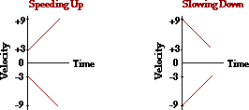
Speeding Up & Slowing Down
Negative acceleration can mean speeding up or slowing down. The same is true with positive acceleration.
Graphics from Minds On Physics

Slide 25
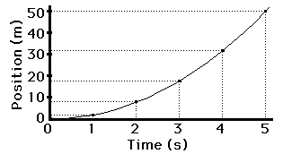
Position – Time for Constant Acceleration
Graphics from Minds On Physics

Slide 26
Motion Up and Down Ramp
What is the velocity at the top of the ramp?
What is the shape of the velocity-time graph?
What is the slope of the velocity-time graph?
What is the acceleration at the top of the ramp?

Slide 27
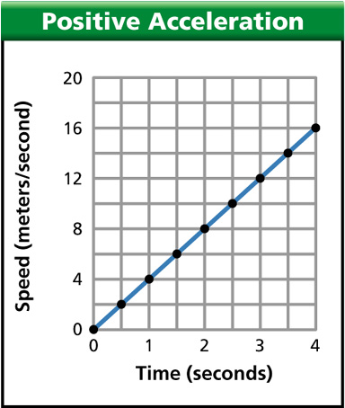
- A constant acceleration produces a straight line or linear slope (rise/run). - The slope of a non-linear velocity-time graph (rise/run) will predict an objects instantaneous acceleration. a = v/t

Slide 28
Positive and Negative Acceleration
Perform “ May the Force Be with You” in the class.

Slide 29
Picturing Acceleration
Discuss the graphs in page. 362-363.
Let the students perform Investigation 11-B “Brush Up Your Graphing Skills” on pages 364-365.
Explain “Estimating Final Velocity” on page 366.
Let the students research one of their favorite scientists. (Oral presentations next meeting, 1 minute each)

Slide 30
11. 3 Inferring Acceleration

Slide 31
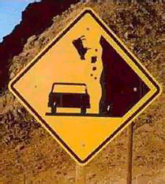
Free Fall
The constant acceleration of an object moving only under the force of gravity is "g".
The acceleration caused by gravity is 9.8 m/s²
If there was no air, all objects would fall at the same speed.
Doesn’t depend on mass.
After 1 second falling at 9.8 m/s
After 2 seconds 19.6 m/s
3 seconds 29.4 m/s

Slide 32
Free Fall
A free-falling object is an object which is falling under the sole influence of gravity.
Free-falling objects do not encounter air resistance.
All free-falling objects on Earth accelerate downwards at a rate of 9.8 m/s/s or 10 m/s/s among friends.

Slide 33
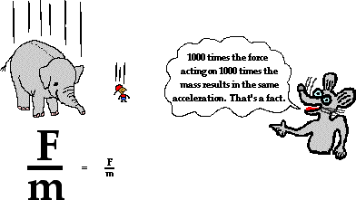
Heavy & Small Objects
In the absence of air resistance, all objects fall with the same acceleration.
Coin and feather in tube.
Hammer and feather on the moon.
Paper and weight.
Graphics from Minds On Physics

Slide 34
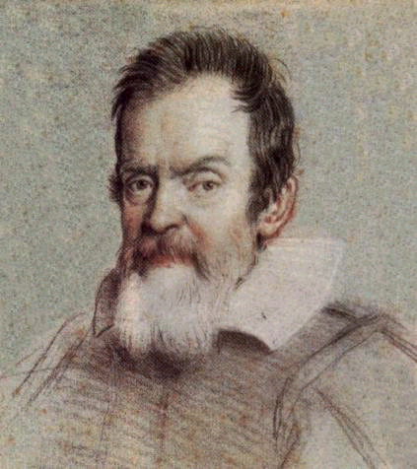
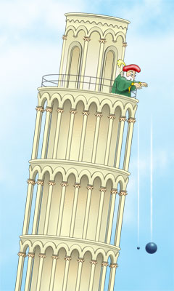
Galileo Galilei
Lived around1600’s
Studied how things fell
Didn’t have a good clock.
Rolled balls down an inclined plane.
Found that the speed increased as it rolled down the ramp.

Slide 35
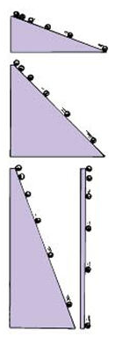
Galileo and the Ramp
Ball rolls down ramp with constant acceleration
What is the value when the ramp is vertical?
9.8 m/s/s or 10 m/s/s
among friends
32 ft/s/s
21 mi/h/s

Slide 36
Free Fall
If the velocity and time for a free-falling object being dropped from a position of rest were tabulated, then one would note the following pattern.
Time (s) Velocity (m/s)
0 0
1 - 9.8
2 - 19.6
3 - 29.4
4 - 39.2
5 - 49.0

Slide 37
Drag
Kinetic friction is a constant force.
If there is a net force an object would accelerate forever.
Air resistance causes a friction called drag.
The direction of drag force is opposite to the velocity.

Slide 38
Terminal Velocity
An object may fall through the air at constant velocity.
By the law of inertia the net force is zero.
The force of drag must balance the force of gravity.
This velocity is called the terminal velocity.
F_{d} = cv²
F_{g} = −mg

Slide 39
Falling Leaves
The drag coefficient depends on the surface area.
Large surfaces – high drag
Leaves
Feathers
Papers
Small surfaces – low drag
Stones
Balls
Bullets

Slide 40
Skydiving
Terminal velocity for a 75-kg skydiver without a parachute is about 120 mph (53. m/s). With a parachute the terminal velocity is 5.1 m/s. What are the drag coefficients?
Balance the weight and drag
mg = cv²
c = mg / v²
Without a parachute:
c = 0.25 kg / m
With a parachute:
c = 28. kg / m

Slide 41
Terminal Velocity
Air resistance will increase as it falls faster.
An upward force on the object.
Eventually gravity will balance with air resistance.
Reaches terminal velocity - highest speed reached by a falling object.

Slide 42
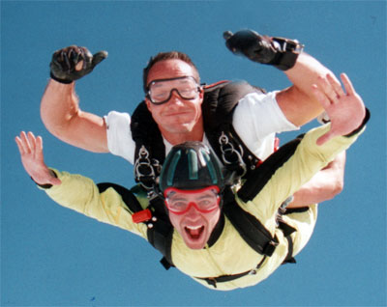
Acceleration of Gravity
Any object which is being acted upon only by the force of gravity is said to be in a state of free fall. There are two important motion characteristics which are true of free-falling objects:
Free-falling objects do not encounter air resistance.
All free-falling objects (on Earth) accelerate downwards at a rate of 9.8 m/s/s (often approximated as 10 m/s/s)

Slide 43
Air Resistance
Air resistance is an upward force exerted on an object as it falls by air.
It is, in essence, a frictional force.
For simplicity, the amount of air resistance is determined by two factors:
The cross-sectional area of the object
The speed of the object

Slide 44
Terminal Velocity
The terminal velocity of a skydiver in a free-fall position with a semi-closed parachute is about 195 km/h
Higher speeds can be attained if the skydiver pulls in his limbs. In this case, the terminal velocity increases to about 320 km/h!
The more compact and dense the object, the higher its terminal velocity will be. Typical examples are the following: raindrop, 25 ft/s, a skydiver was found to be in a range from 53 m/s to 76 m/s

Slide 45
Possible Questions:
What factor causes terminal velocity to occur?
If an object is at terminal velocity, is it speeding up, slowing down, or falling at a constant speed?
Describe and explain how forces change on a falling object.

Slide 46
How the forces change with time.
KEY
Gravity
(constant value & always present…weight)
Air resistance
(friction)
Net force
(acceleration OR changing velocity)

Slide 47
Terminal Velocity
Consider a skydiver:
At the start of his jump the air resistance is _______ so he
____ downwards.
zero
accelerates
2) As his speed increases his air resistance will _______
increase
3) Eventually the air resistance will be big enough to _______ the skydiver’s weight. At this point the forces are balanced so his speed becomes ________ - this is called TERMINAL VELOCITY
balance
constant

Slide 48
Terminal Velocity
Consider a skydiver:
4) When he opens his parachute the air resistance suddenly ________, causing him to start _____ ____.
increases
slowing down
5) Because he is slowing down his air resistance will _______ until it balances his _________. The skydiver has now reached a new, lower ________ _______.
decrease
weight
terminal velocity

Slide 49
Velocity-time graph for the sky diver:
Velocity
Parachute opens – diver slows down
Speed increases…
Terminal velocity reached…
On the Moon
Time
New, lower terminal velocity reached
Diver hits the ground

