Slide 1
math 10 plus
chapter 3
Nanchang No. 2 High School
Ms. Albarico

Slide 2
Table of Contents
3.1 Factors and Multiples of Whole Number
3.2 Perfect Squares, Perfect Cubes, and
Their Roots
3.3 Common Factors of a Polynomial
3.4 Math Lab: Modelling Trinomials as
Binomial Products
3.5 Polynomials of the Form x²+ bx + c
3.6 Polynomials of the Form ax²+ bx + c
3.7 Multiplying Polynomials
3.8 Factoring Special Polynomials

Slide 3
3.1 & 3.2 Curriculum Outcome
Students will be expected to demonstrate an understanding of factors of whole numbers by determining the prime factors, greatest common factor, least common multiple, square root, and cube root.

Slide 4
3.1 & 3.2 Specific Outcomes
Determine the prime factors of a whole number.
Explain why the numbers 0 and 1 have no prime factors.
Determine, using a variety of strategies, the greatest common factor or least common multiple of a set of whole numbers, and explain the process.
Determine, concretely, whether a given whole number is a perfect square, a perfect cube, or neither.
Determine, using a variety of strategies, the square root of a perfect square, and explain the process.
Determine, using a variety of strategies, the cube root of a perfect cube, and explain the process.
Solve problems that involve prime factors, greatest common factors, least common multiples, square roots, or cube roots.

Slide 5
Lesson 3.1

Slide 6
PRIME FACTORIZATION
The prime factorization of a
natural number is the number
written as a product of its
prime factors.

Slide 7
Prime Factorization Quiz Online
Prime Factorization Lecture

Slide 8
Determining the Prime Factors of a Whole Number
Example 1

Slide 9
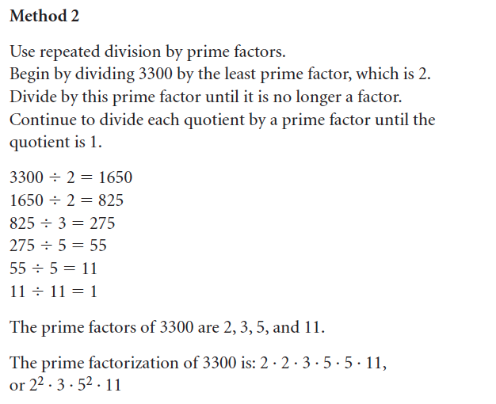
Determining the Prime Factors of a Whole Number
Example 1

Slide 10
GREATEST COMMON FACTOR
The greatest common
factor of two or more
numbers is the greatest
factor the numbers have in
common.

Slide 11
Greatest Common Factor Quiz Online
Greatest Common Factor Module
Greatest Common Factor Activity

Slide 12
Determining the Greatest Common Factor
Example 2

Slide 13
Determining the Greatest Common Factor
Example 2

Slide 14
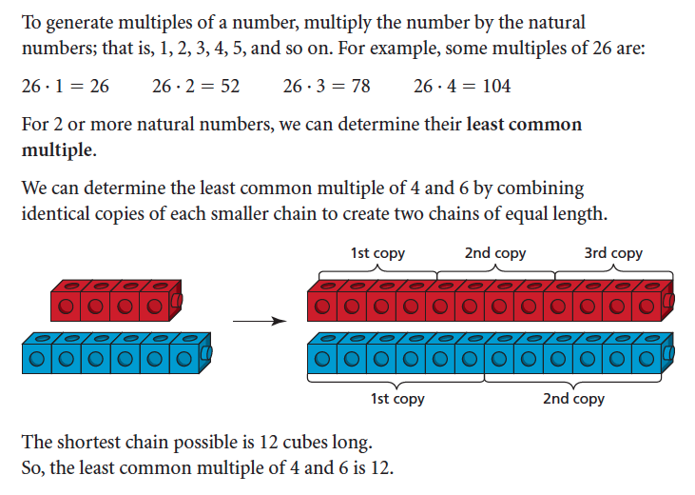
Determining the Greatest Common Factor
Example 2

Slide 15
LEAST COMMON MULTIPLE
The least common multiple of two or more numbers is the least number that is divisible by each number.

Slide 16
Least Common Multiple Game HG
Least Common Multiple Module
Least Common Multiple Game SB

Slide 17
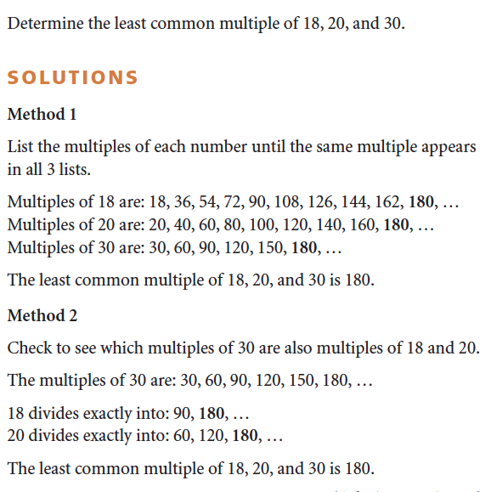
Determining the Least Common Multiple
Example 3

Slide 18
Determining the Least Common Multiple
Example 3

Slide 19
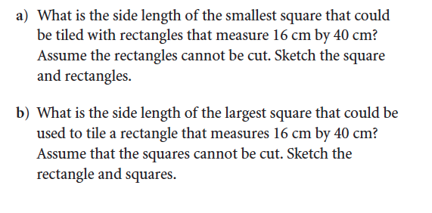
Solving Problems that Involve Greatest Common Factor and Least Common Multiple
Example 4

Slide 20
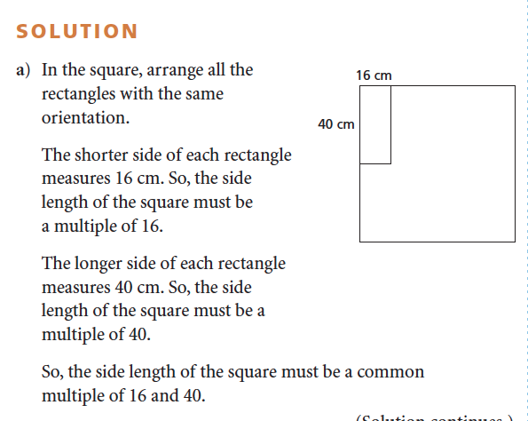
Solving Problems that Involve Greatest Common Factor and Least Common Multiple
Example 4

Slide 21
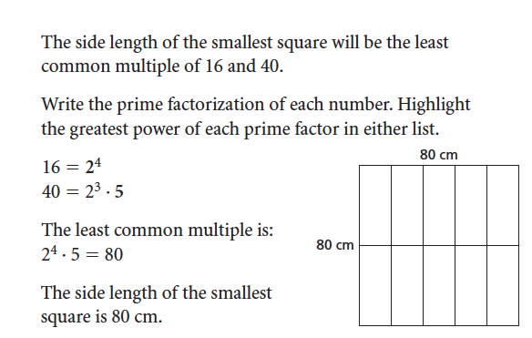
Solving Problems that Involve Greatest Common Factor and Least Common Multiple
Example 4

Slide 22
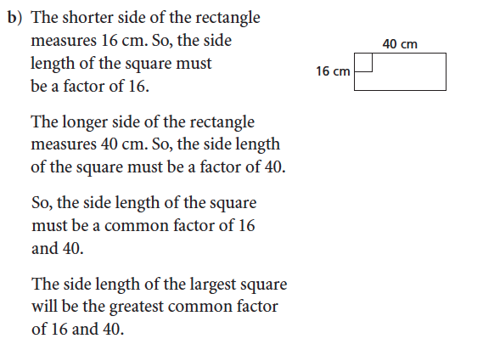
Solving Problems that Involve Greatest Common Factor and Least Common Multiple
Example 4

Slide 23
Solving Problems that Involve Greatest Common Factor and Least Common Multiple
Example 4

Slide 24
PRACTICE EXERCISES
Answer # 3-11(classwork)
13-22 (homework) on
pages 140-141.

Slide 25
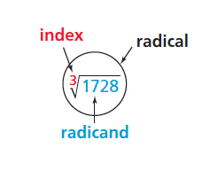
Lesson 3.2

Slide 26
Key Terms
Index -
Radicand -
Radical -

Slide 27
Key Terms

Slide 28
PERFECT SQUARE
Any whole number that can be represented as the area of a square with a whole number side length is a perfect square.
The side length of the square is the square root of the area of the square.

Slide 29
PERFECT SQUARE

Slide 30
Calculator Command
SQUARE ROOT
Press 2nd then x²

Slide 31
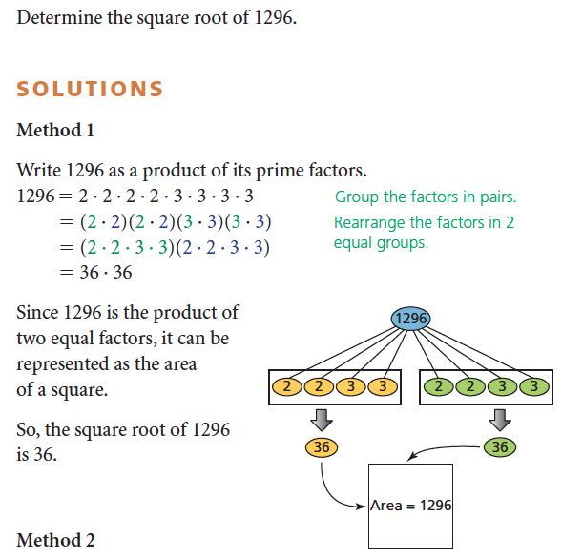
Determining the Square Root of a Whole Number
Example 1

Slide 32
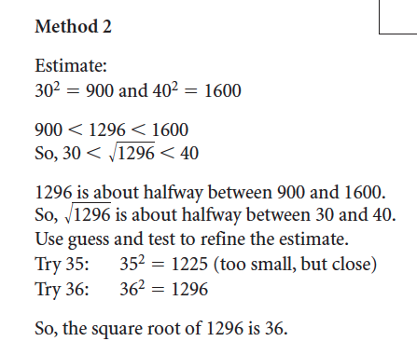
Determining the Square Root of a Whole Number
Example 1

Slide 33
PERFECT CUBE
Any whole number that can be represented as the volume of a cube with a whole number edge length is a perfect cube.
The edge length of the cube is the cube root of the volume of the cube.

Slide 34
PERFECT CUBE

Slide 35
Calculator Command
CUBE ROOT
Press math then choose #4

Slide 36
Determining the Cube Root of a Whole Number
Example 2
Notes:
Play the animation.

Slide 37
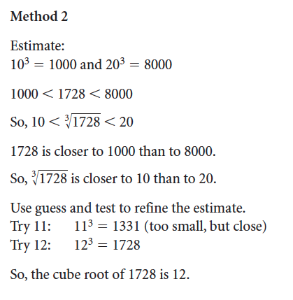
Determining the Cube Root of a Whole Number
Example 2

Slide 38
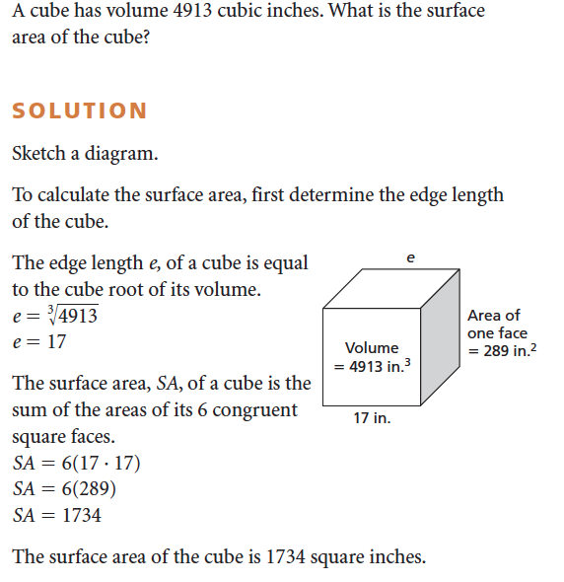
Using Roots to Solve a Problem
Example3

Slide 39
Practice Exercises
Answer # 4-18 on pages 146-147.

Slide 40
Practice Exercises

Slide 41
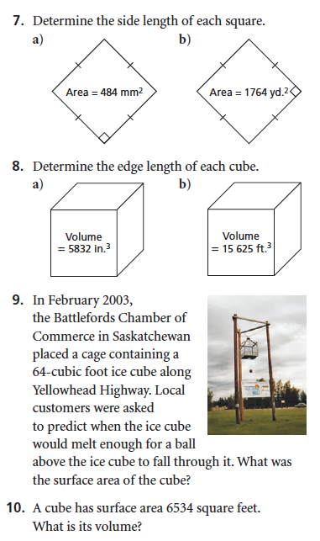
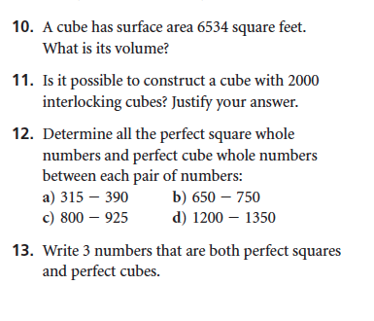

Slide 42
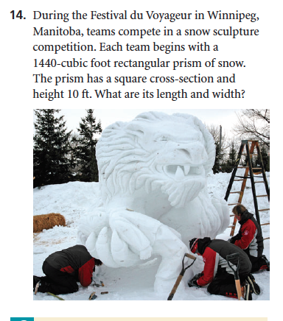
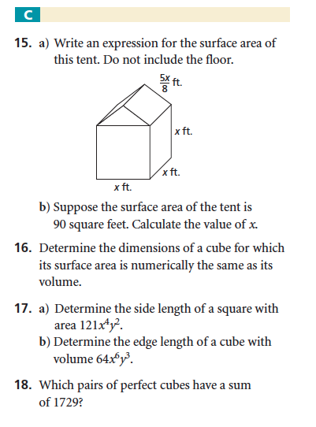

Slide 43
Checkpoint!
Draw the diagram in your notebook on page 148.
Homework!
Answer ASSESS YOUR UNDERTSANDING questions 1-10 in your notebook on page 149.

Slide 44
EXTRA LESSON – CUBE ROOT

Slide 45
Objective: You will be able to determine if a number is a perfect cube and to find the cube root of a number that is a perfect cube.

Slide 46
Perfect Cubes and Cube Roots
Remember
A cube is a three dimensional prism with 6 square faces; so all sides are congruent and all angles are right angles.

Slide 47
Perfect Cubes and Cube Roots
Squares and Cubes:
Similarities
- All sides congruent
- All angles 90 degrees
Differences:
- Square is 2 dimensional
- Cube is 3 dimensional that number’s square root.

Slide 48
Perfect Cubes and Cube Roots
Remember
A number is a perfect square if you can take that many 1 x 1 unit squares and form them into a square. The side length of the square you form is that number’s square root.

Slide 49
Perfect Cubes and Cube Roots
A number is a perfect cube if you can take that many 1 x 1 x 1 unit cubes and form them into a cube. The side length of the cube you form is that number’s cube root.is that number’s square root.

Slide 50
Perfect Cubes and Cube Roots
Is 8 a perfect cube?
that number’s square root.

Slide 51
Perfect Cubes and Cube Roots
that.

Slide 52
Perfect Cubes and Cube Roots
that.

Slide 53
Perfect Cubes and Cube Roots
8 is a perfect cube and its cube root is 2

Slide 54
Perfect Cubes and Cube Roots
Is 5 a perfect cube?

Slide 55
Perfect Cubes and Cube Roots
Is 5 a perfect cube?

Slide 56
Perfect Cubes and Cube Roots
Three Dimensions
Perfect Cube
Volume

Slide 57
Perfect Cubes and Cube Roots
Perfect Cube: 8 Cube Root 2
Volume: 8 units³ Side Length: 2 units

Slide 58
Perfect Cubes and Cube Roots
Side Length | Volume Operation | Volume | Perfect Cube
2 units | 2 x 2 x 2 | 8 units³ | 8

Slide 59
Perfect Cubes and Cube Roots
Perfect Cube: Cube Root
Volume: units³ Side Length: units

Slide 60
Perfect Cubes and Cube Roots
Side Length | Volume Operation | Volume | Perfect Cube
1 unit | 1 x 1 x 1 | 1 units³ | 1
2 units | 2 x 2 x 2 | 8 units³ | 8

Slide 61
Perfect Cubes and Cube Roots
Perfect Cube: Cube Root
Volume: units³ Side Length: units

Slide 62
Perfect Cubes and Cube Roots
Side Length | Volume Operation | Volume | Perfect Cube
1 unit | 1³ | 1 units³ | 1
2 units | 2³ | 8 units³ | 8
3 units | 3³ | 27 units³ | 27

Slide 63
Perfect Cubes and Cube Roots
Side Length | Volume Operation | Volume | Perfect Cube
1 unit | 1³ | 1 units³ | 1
2 units | 2³ | 8 units³ | 8
3 units | 3³ | 27 units³ | 27
4 units

Slide 64
Perfect Cubes and Cube Roots
Side Length | Volume Operation | Volume | Perfect Cube
1 unit | 1³ | 1 units³ | 1
2 units | 2³ | 8 units³ | 8
3 units | 3³ | 27 units³ | 27
4 units | 4³

Slide 65
Perfect Cubes and Cube Roots
Side Length | Volume Operation | Volume | Perfect Cube
1 unit | 1³ | 1 units³ | 1
2 units | 2³ | 8 units³ | 8
3 units | 3³ | 27 units³ | 27
4 units | 4³ | 64 units³

Slide 66
Perfect Cubes and Cube Roots
Side Length | Volume Operation | Volume | Perfect Cube
1 unit | 1³ | 1 units³ | 1
2 units | 2³ | 8 units³ | 8
3 units | 3³ | 27 units³ | 27
4 units | 4³ | 64 units³ | 64

Slide 67
Perfect Cubes and Cube Roots
Side Length | Volume Operation | Volume | Perfect Cube
1 unit | 1³ | 1 units³ | 1
2 units | 2³ | 8 units³ | 8
3 units | 3³ | 27 units³ | 27
4 units | 4³ | 64 units³ | 64
S units | S³ | S³ units³ | S³

Slide 68
Perfect Cubes and Cube Roots
Side Length of cube | Volume Operation | Volume of cube | Perfect Cube
1 unit | 1³ | 1 units³ | 1
2 units | 2³ | 8 units³ | 8
3 units | 3³ | 27 units³ | 27
4 units | 4³ | 64 units³ | 64
S units | S³ | S³ units³ | S³
10 units

Slide 69
Perfect Cubes and Cube Roots
Side Length of cube | Volume Operation | Volume of cube | Perfect Cube
1 unit | 1³ | 1 units³ | 1
2 units | 2³ | 8 units³ | 8
3 units | 3³ | 27 units³ | 27
4 units | 4³ | 64 units³ | 64
S units | S³ | S³ units³ | S³
10 units | 10³

Slide 70
Perfect Cubes and Cube Roots
Side Length of cube | Volume Operation | Volume of cube | Perfect Cube
1 unit | 1³ | 1 units³ | 1
2 units | 2³ | 8 units³ | 8
3 units | 3³ | 27 units³ | 27
4 units | 4³ | 64 units³ | 64
S units | S³ | S³ units³ | S³
10 units | 10³ | 1000 u³

Slide 71
Perfect Cubes and Cube Roots
Side Length of cube | Volume Operation | Volume of cube | Perfect Cube
1 unit | 1³ | 1 units³ | 1
2 units | 2³ | 8 units³ | 8
3 units | 3³ | 27 units³ | 27
4 units | 4³ | 64 units³ | 64
S units | S³ | S³ units³ | S³
10 units | 10³ | 1000 u³ | 1000

Slide 72
Perfect Cubes and Cube Roots
Square Root
$√$

Slide 73
Perfect Cubes and Cube Roots
Square Root Cube Root
$√$ $∛$

Slide 74
Perfect Cubes and Cube Roots
Square Root Cube Root
$√$ $∛$

Slide 75
Perfect Cubes and Cube Roots
Square Root Cube Root
$√$ $∛$

Slide 76
Perfect Cubes and Cube Roots
Practice
$∛64$

Slide 77
Perfect Cubes and Cube Roots
Practice
Is 827 a perfect cube?

Slide 78
Conclusion: You can now determine if a number is a perfect cube and find the cube root of a number that is a perfect cube.

