Slide 1
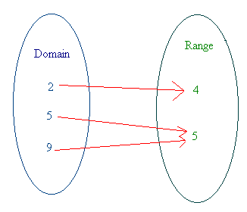
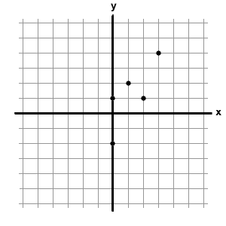
RELATIONS AND FUNCTIONS
UNIT 3

Slide 2
RELATIONS AND FUNCTIONS
5.1 – Representing Relations
5.2 – Properties of Functions
5.3 – Interpreting and Sketching Graphs
5.4 – Graphing Data
5.5 – Graphs of Relations and Functions
5.6 – Properties of Linear Equations
5.7 – Interpreting Graphs of Linear Functions

Slide 3
REPRESENTING Relations
5.1

Slide 4
Students are expected to:
Graph, with or without technology, a set of data, and determine the restrictions on the domain and range.
Explain why data points should or should not be connected on the graph for a situation.
Describe a possible situation for a given graph.
Sketch a possible graph for a given situation.
Determine, and express in a variety of ways, the domain and range of a graph, a set of ordered pairs, or a table of values.

Slide 5
Key Terms
arrow diagram
relation
function
set
element

Slide 6
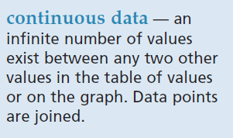
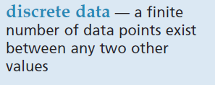
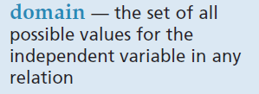
Key Terms

Slide 7
Vocabulary
Write 30-40 vocabulary from Chapter 5.

Slide 8
Homework
Explore our website. Check out Unit 3 webpage, especially on the Media Resources.

Slide 9
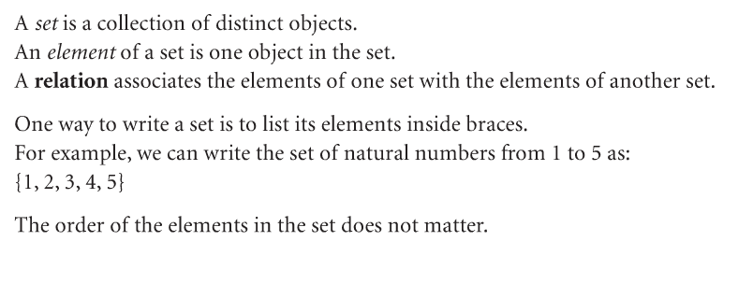
Introduction

Slide 10
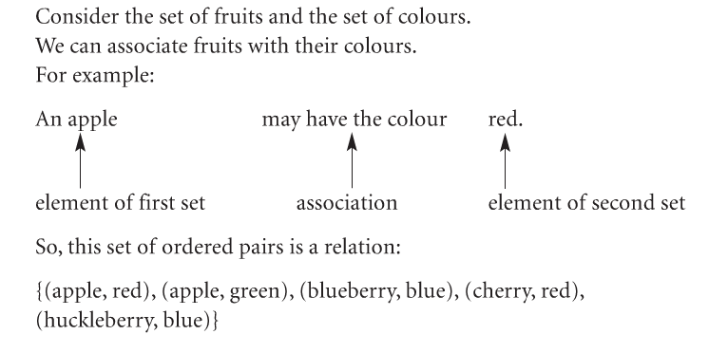
Example:

Slide 11
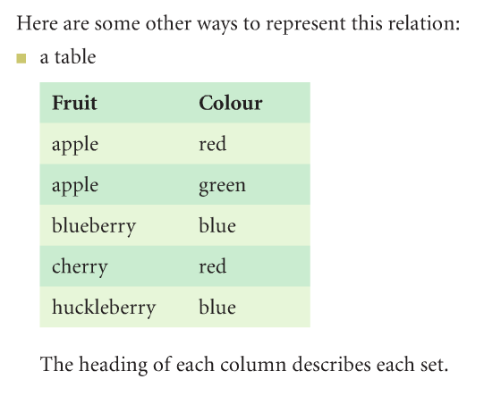

Slide 13
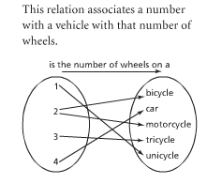
A Relation is a rule that produces one or more
output numbers for every valid input number
(x and y values may be repeated).
This represents only a relation
because the input value or
x-value of 2 was used twice.
Therefore this relation is not a
Function.
All functions are relations but not all relations are functions!

Slide 14
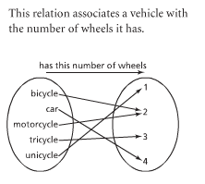
Function
X values are always located
on the right and y values are
on the left.
They can be represented by
words, symbols or numbers.
This represents a function as every input value (x) has only been used once.

Slide 15
Relations and functions can be shown many
different ways.
Are these relations or functions?
Function
&
Relation
x
y
1
2
3
4
5
6
7
x y
5
6
7
6
(1, 5), (2, 6), (3, 7), (4, 6)

Slide 16
Are these relations or functions?
Not a Function but a
Relation
x
y
1
2
5
6
7
x y
5
6
1 7
1 6

Slide 17
How about some more definitions? The domain is the
set of 1st coordinates of the ordered pairs.
The range is the
set of 2nd coordinates of the ordered pairs.
A relation is a
set of ordered pairs.

Slide 18
Given the relation {(3,2), (1,6), (-2,0)}, find the domain and range.
Domain = {3, 1, -2}
Range = {2, 6, 0}

Slide 19
What would this be? {(2,4), (3,-1), (0,-4)}
A bad relationship!! Ha! Ha!

Slide 20
The relation {(2,1), (-1,3), (0,4)} can be shown by
x
y
1) a table.
2) a mapping.
3) a graph.
2
-1
0
1
3
4
2
-1
0
1
3
4

Slide 21
Given the following table, show the relation, domain, range, and mapping. x -1 0 4 7 y 3 6 -1 3
Relation = {(-1,3), (0,6), (4,-1), (7,3)}
Domain = {-1, 0, 4, 7}
Range = {3, 6, -1, 3}

Slide 22
Mapping x -1 0 4 7 y 3 6 -1 3
-1
0
4
7
3
6
-1
You do not need to write 3 twice in the range!

Slide 23
Example 1- 3
Refer to the textbook. Page 259-262

Slide 24
Class Exercises
Refer Sample problems from the textbook on page 259-260
Refer Check Your Understanding, # 3-14 on pages 262-263

Slide 25
Domain: a set of first elements in a relation
(all of the x values). These are also called
the independent variable.
Range: The second elements in a relation
(all of the y values). These are also called
the dependent variable.

Slide 26
How would you use your calculator to solve 5²?
Input
Output
5
x²
25
The number you entered is the input number (or x-value on a graph).
The result is the output number (or y-value on a graph).
What is the calculator commands?

Slide 27
A function is a relation that gives a single
output number for every valid input number
(x values cannot be repeated).
A relation is a rule that produces one or more
output numbers for every valid input number
(x and y values may be repeated).
There are many ways to represent relations:
Graph
Equation
Table of values
A set of ordered pairs
Mapping
These are all ways of showing a relationship between two variables.

Slide 28
Are these relations or functions?
x
y
Not a function
But a relation
1
2
3
5
6
8
11
x y
5
6
11
8

Slide 29
In words:
Double the number and add 3
As an equation:
y = 2x + 3
These all represent the SAME function!
As a table of values:
x y
-2 -1
-1 1
0 3
1 5
As a set of ordered pairs:
(-2, -1) (-1,1) (0,3) (1, 5) (2, 7) (3, 9)

Slide 30
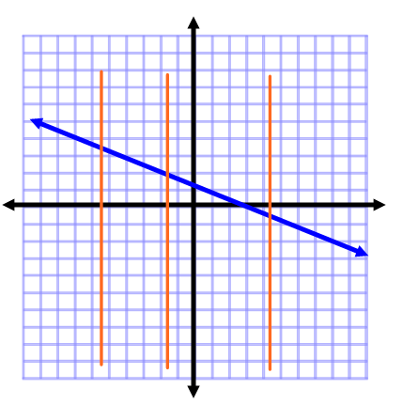
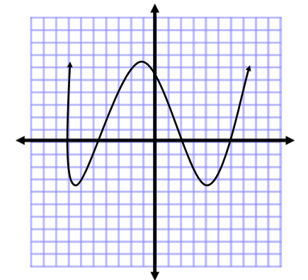
Vertical Line Test: if every vertical line you can draw goes through only 1 point then the relation is a function.

Slide 31
Check Your Understanding

Slide 32
What is the domain of the relation {(2,1), (4,2), (3,3), (4,1)}
{2, 3, 4, 4}
{1, 2, 3, 1}
{2, 3, 4}
{1, 2, 3}
{1, 2, 3, 4}
Answer Now

Slide 33
What is the range of the relation {(2,1), (4,2), (3,3), (4,1)}
{2, 3, 4, 4}
{1, 2, 3, 1}
{2, 3, 4}
{1, 2, 3}
{1, 2, 3, 4}
Answer Now

Slide 34
Inverse of a Relation: For every ordered pair (x,y) there must be a (y,x). Write the relation and the inverse.
-1
3
4
-6
-4
2
Relation = {(-1,-6), (3,-4), (3,2), (4,2)}
Inverse = {(-6,-1), (-4,3), (2,3), (2,4)}

Slide 35
Write the inverse of the mapping.
4
3
-1
2
-3
{(4,-3),(2,-3),(3,-3),(-1,-3)}
{(-3,4),(-3,3),(-3,-1),(-3,2)}
{-3}
{-1, 2, 3, 4}
Answer Now

Slide 36
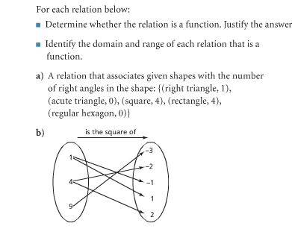
a)
b)

Slide 37
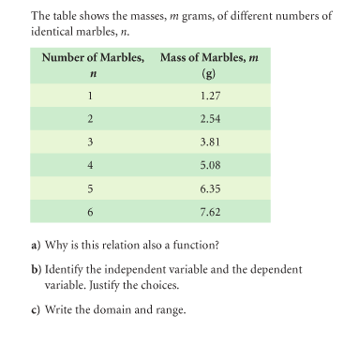
a)
b)
c)

Slide 38
Class work:
Answer CYU # 4-9 on pages 270-271.

Slide 39
Homework
Answer CYU # 14-16, 19-23 on pages 272-273.

Slide 40
References
teachers.henrico.k12.va.us/
sms8thmath.weebly.com/

