Slide 1
FINANCIAL MATHEMATICS
MATH 10 – UNIT 4

Slide 2
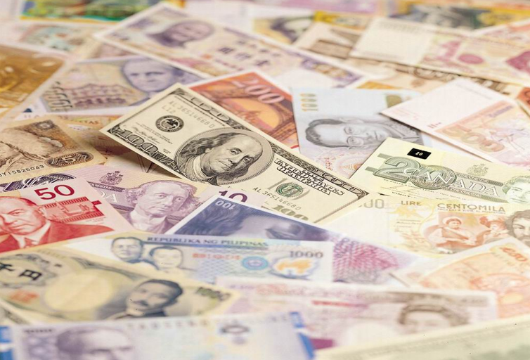
CURRENCY EXCHANGE

Slide 3
Students are expected to:
Solve, using proportional reasoning, a contextual problem that involves currency exchange.
Explain the difference between the selling rate and purchasing rate for currency exchange.
Explain how to estimate the cost of items in Canadian currency while in a foreign country, and explain why this may be important.
Convert between Canadian currency and foreign currencies, using formulas, charts, or tables.

Slide 4
Vocabulary
investigate
convert
electronic equipment
worth
avoid
souvenirs
purchases
helmet

Slide 5
Currency
a system of money in general use in a particular country.
something that is used as a medium of exchange; money.

Slide 6
Key Terms
Exchange rate – a rate that specifies how much one currency is worth in terms of the other
also knows as the foreign-exchange rate
Proportion – an equation that’s says two rates or ratios are equal

Slide 7
Key Terms
Buying Rate – rate a bank pays when buying foreign currency from a customer
Selling Rate – rate a bank pays when selling foreign currency from a customer

Slide 8
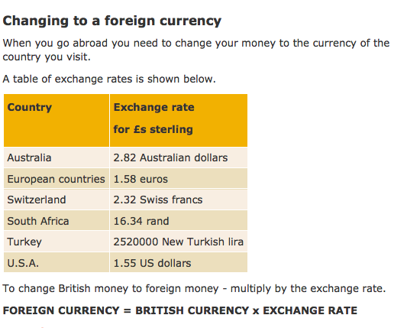

Slide 9
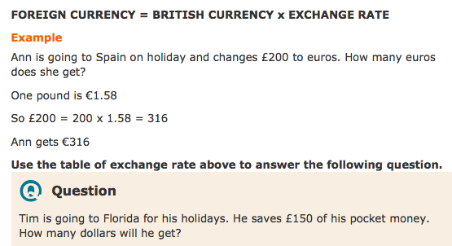

Slide 10
Top Ten Currencies

Slide 13
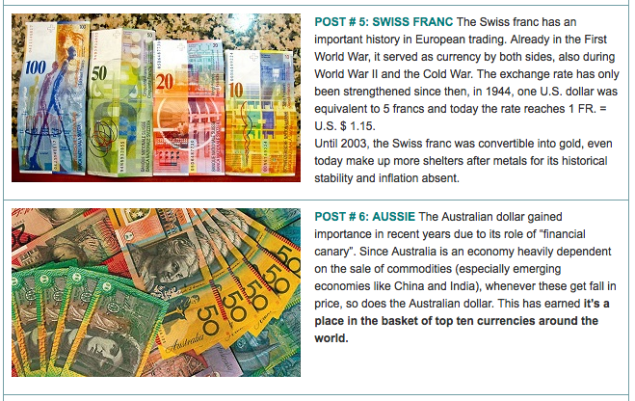

Slide 14
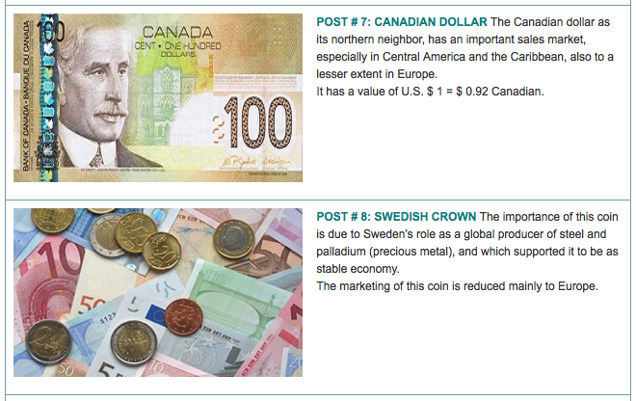

Slide 16
Most Expensive Currencies

Slide 17
Read more about currency at:
http://hapiland.net/1793/canadian-currency-money-canada/
http://www.fopsobserver.com/?p=4545
http://www.cpawc.com/home/shooting-in-western-canada/currency/
http://www.whichcountry.co/top-ten-currencies-in-the-world/
http://www.mapsofworld.com/world-top-ten/world-map-richest-countries-currency.html
http://lakhot.com/10-Most-Expensive-Currencies-in-the-World.php
http://www.bbc.co.uk/bitesize/standard/maths_i/numbers/foreign_exchange/revision/1/

